Slide 1
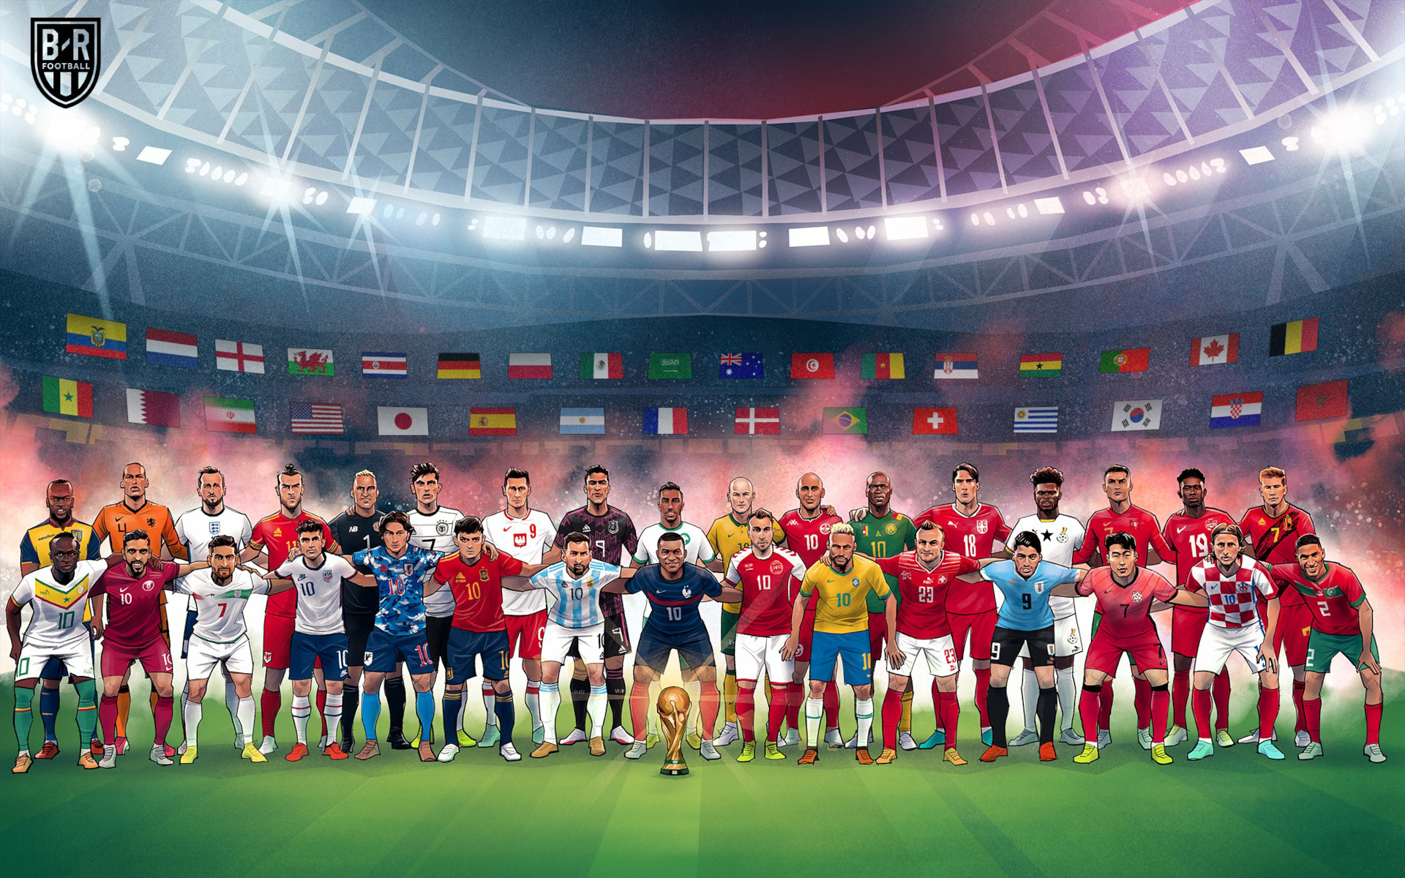
CORRELATION IS CAUSATION
Global Football Diversity:
Exploring the Impact of Multinational Players in World Cups
Antonio Pio Lupo | Hossein Yousefian | Fatemeh Amirian | Mohammadhadi Shahhosseini | Pooya Sabbagh Savoojbulagh | Franco Bonifacini

